Slide 1
Employee Salary Prediction(using machine learning algorithms)
CAPSTONE PROJECT
Presented By: ABHINISHT SINGH
University Name : United University
AICTE ID : STU681ef9454a521746860367
COURSE & DEPARTMENT : BCA-IBM , Computer Application

Slide 2
OUTLINE
Problem Statement
System Development Approach
Algorithm & Deployment (Step by Step Procedure)
Result
Conclusion
Future Scope
References

Slide 3
Problem Statement
My project predicts employee salary based on multiple input features such as experience, education, job role, and industry.
This tool can be used by HR departments and corporate planners to streamline salary forecasting, ensure competitive compensation, and support data-driven decision-making across diverse organizational structures.

Slide 4
System Approach
System Requirements:
OS: Windows 10/11, macOS, or Linux
Python: Version 3.8 or higher
RAM: Minimum 4 GB (8 GB recommended)
Browser: Chrome, Firefox, Edge (for accessing Streamlit UI)

Slide 5
System Approach
Required Libraries:
Streamlit: Creating the interactive web application frontend
Numpy: Numerical computations and array operations
Scikit-learn: For Machine learning algorthim and preprocessing
Matplotlib: For Visualization
Pyngrok: Used to create a public URL for your local Streamlit app.
Threading: Used to run multiple operations simultaneously, like running Streamlit and ngrok at the same time.
Joblib: Used to save and load machine learning models efficiently.

Slide 6
Algorithm & Deployment
Step 1: Import Library
Step 2: Load the Data set
Step 3: Preprocessing
Handle Missing value
Encode categorical variables
Splitting Features (X) and Target Variable (y)
Step 4: Exploratory Data Analysis (EDA) - Outlier Detection

Slide 7
Algorithm & Deployment
Step 5: Model Training and Prediction(using different M.L algorithms)
Step 6: Model Comparison using Pipelines with the help of bar graph
Step 7: Model Evaluation using Accuracy Score for different algorithm
Step 8: Deploy trained machine learning model as an interactive application.

Slide 8
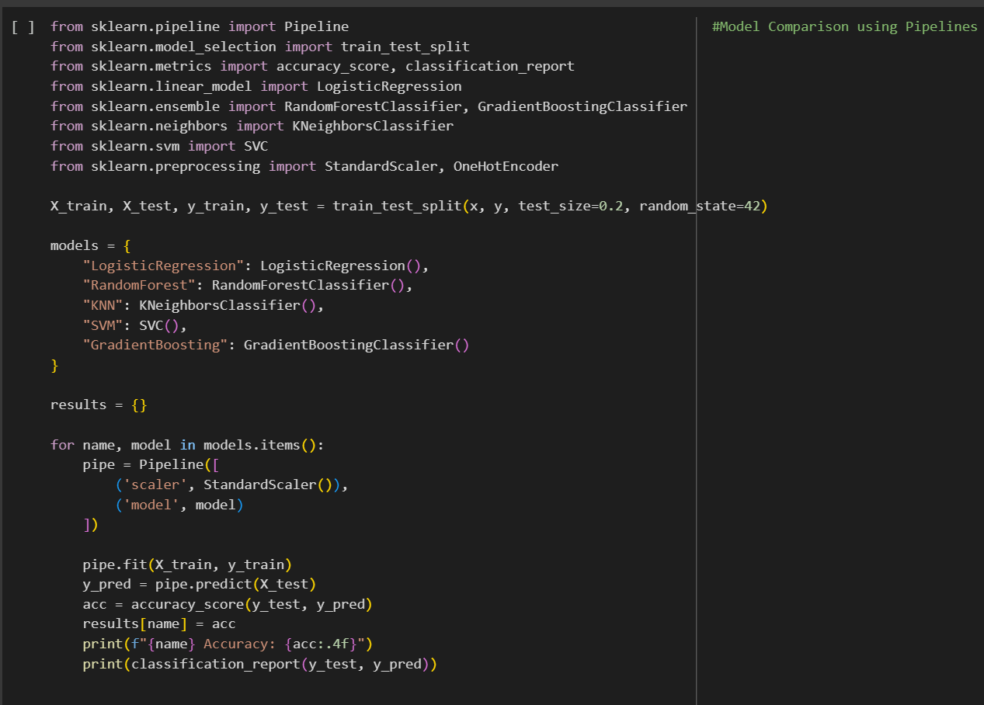
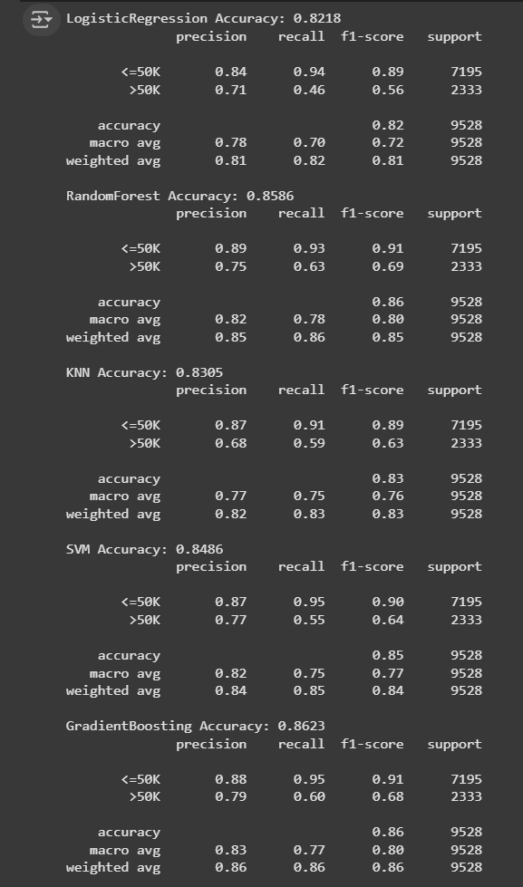
Result
Model Comparison using Pipelines:
Output:

Slide 9
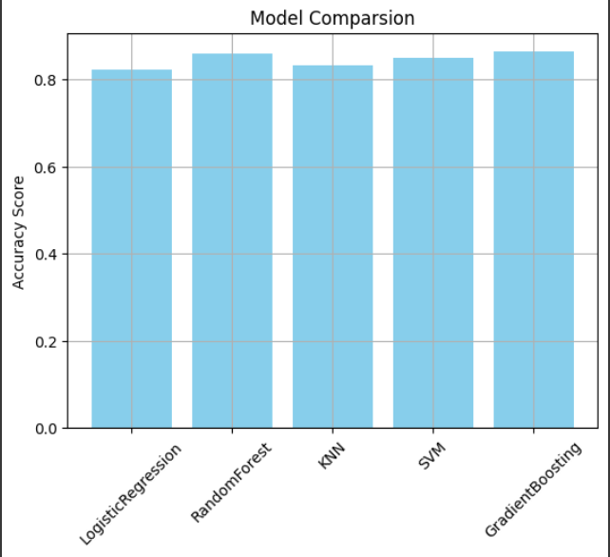
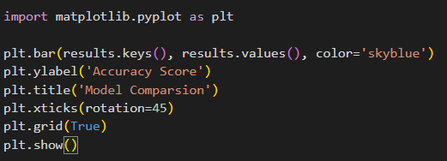
Result
Model Comparsion:

Slide 10
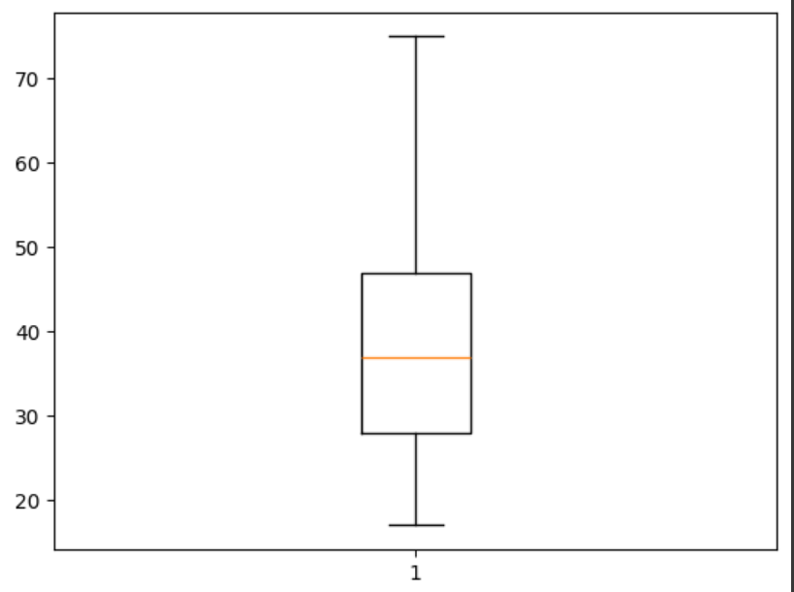
Result
Box Plot:

Slide 11
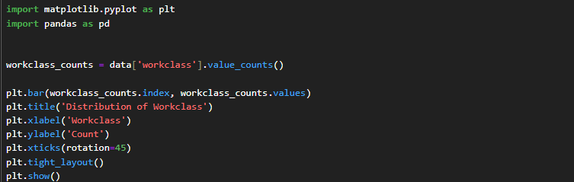
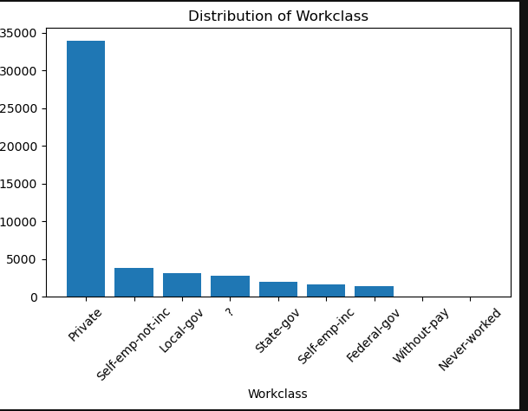
Result
Bar graph

Slide 12
Result
Github link:
https://github.com/Abhinisht/EMPLOYEE-SALARY-PREDICATION--Abhinisht-Singh

Slide 13
Conclusion
Finding:
Model Training & Evaluation:
Multiple machine learning models (Logistic Regression, Random Forest, KNN, SVM, Gradient Boosting) were trained to predict employee salary class.
Model Deployment:
A user-friendly Streamlit web application was developed to:
Collect employee details via an interactive UI

Slide 14
Conclusion
This tool can be used by managemnt department and corporate planners to streamline salary forecasting, ensure competitive compensation, and support data-driven decision-making across diverse organizational structures.

Slide 15
Future scope(Optional)
Dynamic Visualization:-
We can add Interactive Dashboard, which can be easy to Understand for the management , to track and chase the individual growth of each employee
NLP Engagement :-
We will add national language processor , whereas Deep Learning Models (GANS ,CNNs) to increase the complex understanding and make effective predication as per the human understanding in unbiased manner

Slide 16
References
https://jmlr.org/papers/volume12/pedregosa11a/pedregosa11a.pdf
https://pandas.pydata.org/
https://streamlit.io/
https://matplotlib.org/

Slide 17
THANK YOU

